Slide 1
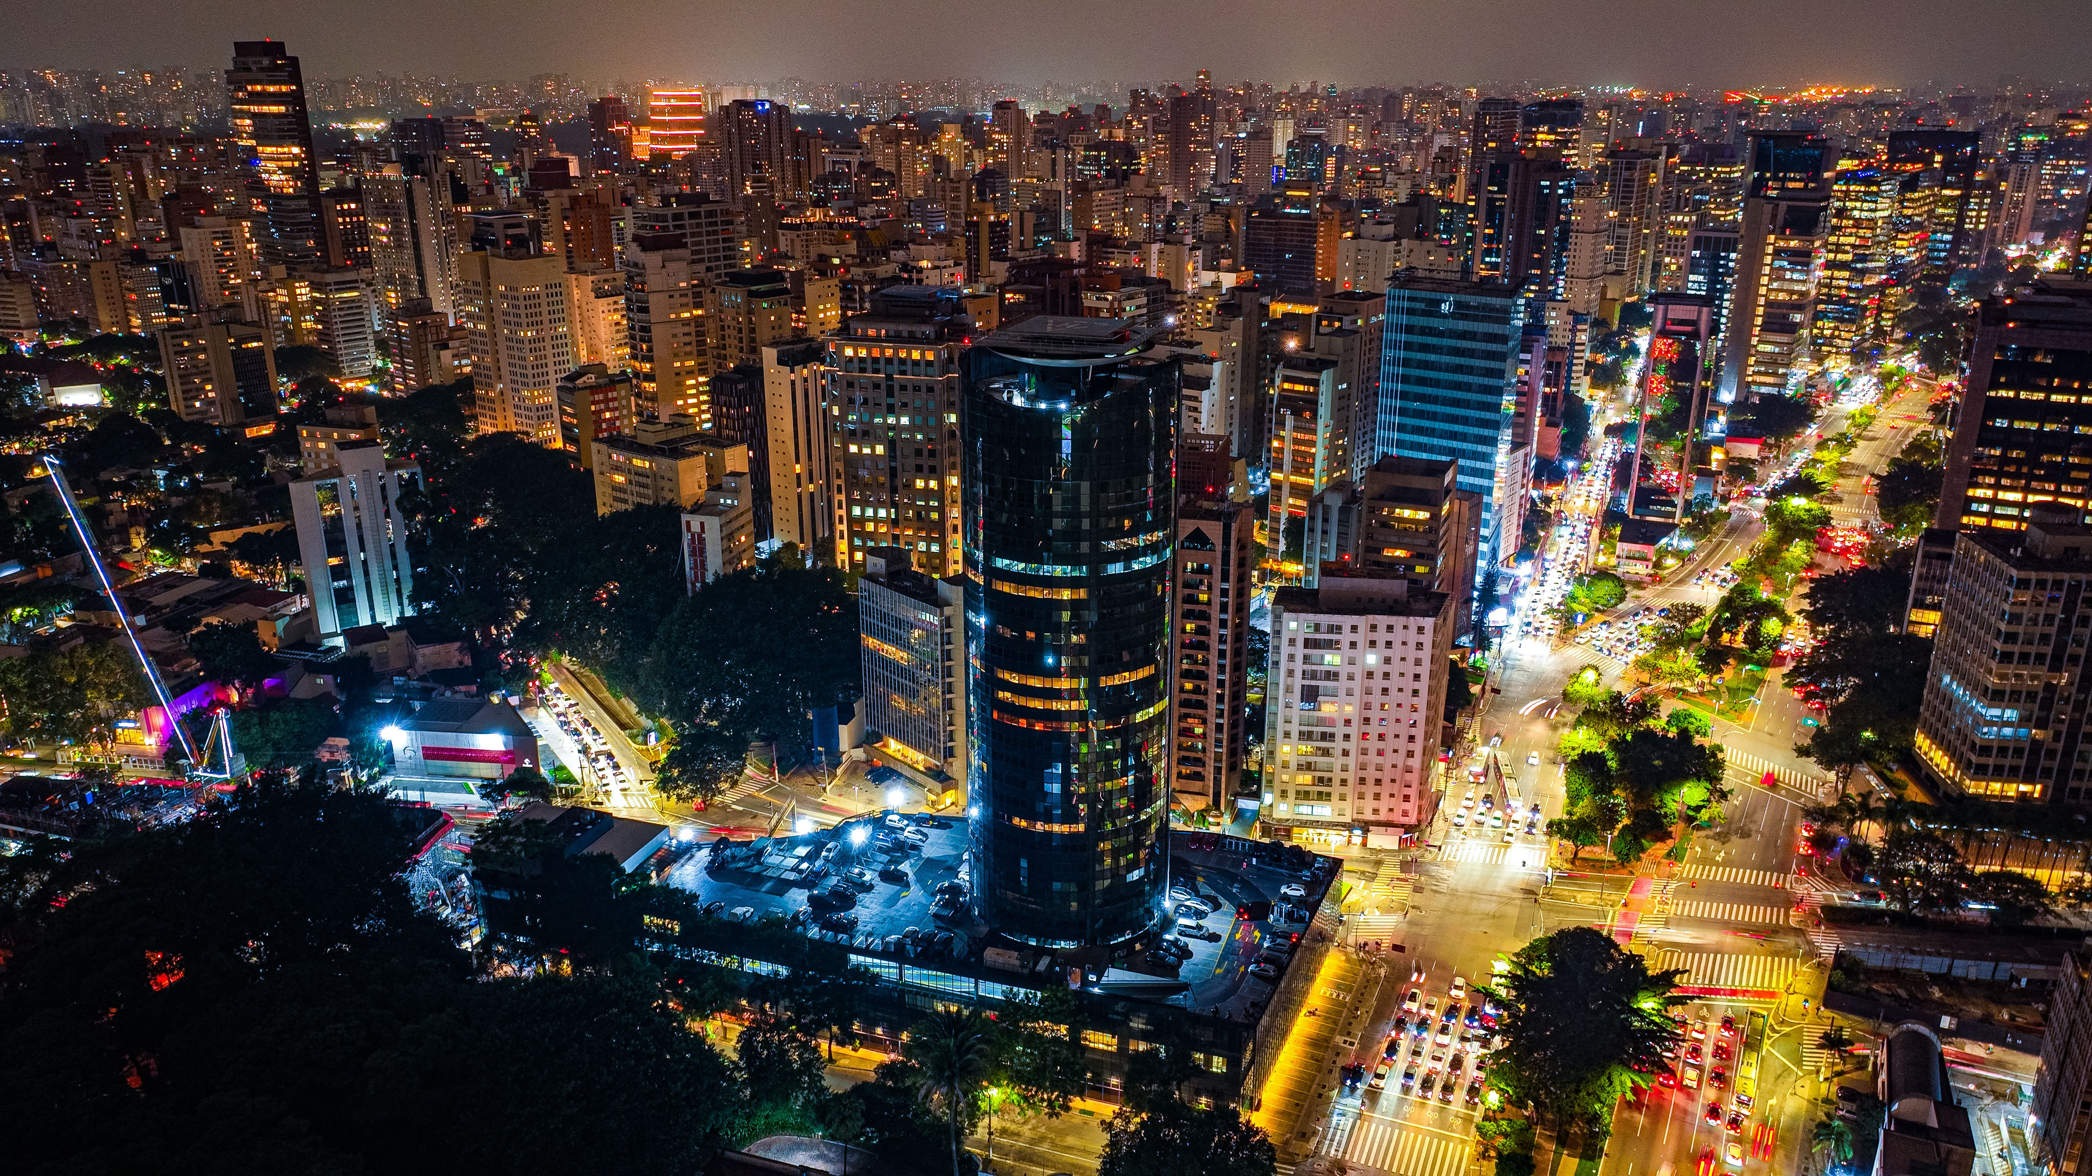
LIVING STONES FOUNDATION
Applied Data & Digital Innovation Lab · LATAM
Economic Development
in Latin America
A data-driven analysis of economic growth, resilience, and social development
across six Latin American economies, 2014–2024
Prepared by Manar Mohammed · Volunteer Data Analyst
World Bank Open Data · 2014–2024

Slide 2
OVERVIEW
What this presentation covers
01
Project Objective & Scope
Why this analysis, and what it does (and doesn't) cover
02
Data & Methodology
World Bank indicators, six countries, five-phase pipeline
03
Key Findings
What the data reveals about growth, crisis, and resilience
04
Progress & Next Steps
What's complete, and what comes next
LIVING STONES FOUNDATION · APPLIED DATA & DIGITAL INNOVATION LAB
2

Slide 3
SECTION 01
Project objective
In scope
To analyze the key factors influencing economic development in Latin America through a data-driven approach, identifying meaningful patterns across economic and social indicators to support evidence-based decision-making.
Descriptive analysis, trend detection, cross-country comparison
Out of scope
Causal claims, predictive modeling, policy prescriptions
LIVING STONES FOUNDATION · APPLIED DATA & DIGITAL INNOVATION LAB
3

Slide 4
SECTION 01
Data source & scope
6
12
11
792
Countries
Indicators
Years (2014–2024)
Data points
World Bank Open Data: World Development Indicators
Publicly available, internationally recognized indicators covering economic growth, labor markets, prices, health, poverty, investment, and connectivity.
Argentina
Brazil
Chile
Colombia
Mexico
Peru
Indicators: GDP per capita · GDP growth · Unemployment · Inflation · Life expectancy · School enrollment · Poverty rate · FDI · Population · Urban population · Internet access · Electricity access
LIVING STONES FOUNDATION · APPLIED DATA & DIGITAL INNOVATION LAB
4

Slide 5
SECTION 02
A five-phase analysis pipeline
01
02
03
04
05
Planning
Collection
Cleaning & EDA
Visualization
Documentation
Topic & scope
definition
World Bank data
acquisition
Missing values,
reshaping, analysis
Interactive Power BI
dashboard
Findings, methodology,
final report
Estimated timeline: ~5 weeks, adjusted based on data availability and analysis depth.
LIVING STONES FOUNDATION · APPLIED DATA & DIGITAL INNOVATION LAB
5

Slide 6
SECTION 03 · KEY FINDING 01
2020 was a compounding, region-wide crisis
All six countries saw GDP per capita fall and unemployment spike in the same year, consistent with the global economic impact of COVID-19.
-9.5% to -21.7%
GDP per capita decline range across all six countries, 2019→2020 (Chile least affected, Brazil most affected)
+5.7 pts
Colombia's unemployment rise in 2020, to 15.98% (the highest in the dataset), coinciding with its lowest GDP per capita value
LIVING STONES FOUNDATION · APPLIED DATA & DIGITAL INNOVATION LAB
6

Slide 7
SECTION 03 · KEY FINDING 02
Argentina's inflation is accelerating, not just rising
Year-over-year increases have grown sharply since 2021, reaching 219.9% in 2024, over 15x the regional median.
Why it matters
Argentina's inflation trajectory aligns with the highest GDP volatility observed in the dataset (STD ≈ $1,969 vs. Peru's $738), suggesting inflation as a likely driver of its broader economic instability, not an isolated event.
Note: pre-2018 inflation data for Argentina was unavailable in the World Bank dataset.
LIVING STONES FOUNDATION · APPLIED DATA & DIGITAL INNOVATION LAB
7

Slide 8
SECTION 03 · KEY FINDING 03
Chile leads consistently across every dimension
Economic strength, investor confidence, health outcomes, and poverty reduction all point to the same country.
Highest GDP per capita
Highest FDI inflow
$17,081 (2023), a consistent structural gap over the other five countries throughout 2014-2024
9.84% of GDP (2014), the strongest investor confidence recorded in the dataset
Lowest poverty rate
Smallest life expectancy drop
6.5% (2022), the lowest national poverty rate among all six countries
-1.45 years during 2019-2021, versus -4.78 in Mexico, the most resilient health outcome in the region
LIVING STONES FOUNDATION · APPLIED DATA & DIGITAL INNOVATION LAB
8

Slide 9
SECTION 04
Where the project stands today
ALREADY IN PLACE
NEXT TO BUILD
Topic scoping & approved project white paper
World Bank data collection
Full data cleaning (12 indicators, 6 countries)
Exploratory analysis: 16 documented insights
Interactive 3-page Power BI dashboard
Final written documentation & methodology report
GitHub repository with reproducible analysis notebook
Interactive web application (App phase, to be scoped with the team)
LIVING STONES FOUNDATION · APPLIED DATA & DIGITAL INNOVATION LAB
9

Slide 10
A credible baseline for evidence-based
decision-making in Latin America
Five years of consistent, comparable data across six economies, ready to inform the next phase of this project.
Thank you
Manar Mohammed · Volunteer Data Analyst · Living Stones Foundation

